Slide 1

Schema Design
Sept 2016

Slide 2
Schema
A schema is:
Generic: a structured framework or plan
Database: the structure of a database system, described in a formal language that defines the tables, the fields in each table, and the relationships between fields and tables
XML/JSON: a description of the elements in a document that can be used to validate each piece of content
A schema can be:
abstract or concrete
formal (written in a syntax definition language) or informal

Slide 3
Abstract Syntax*
An Abstract Syntax Language is:
A formal language for specifying the logical structure of data that is to be exchanged between two endpoints
independent of hardware platform, operating system, programming language, local representation, etc.
Standard sets of rules for encoding instances of logical data structures that are specified in abstract notation
for the purpose of transmission
* Description and Principles by Allesandro Trigila
http://www.ieee802.org/802_tutorials/2010-11/
Describes ASN.1, but applies to any abstract syntax language

Slide 4
Principles and Benefits* of abstract syntax
Separation of concerns
The description of the logical structure of a message is kept completely separate from the details of the encoding
Message descriptions are machine-processable
This enables the creation and use of software development tools and testing tools that can read and understand the formal definitions
Encodings are standardized
The problem of specifying detailed encodings and the problem of encoding/decoding messages and their fields do not need to be addressed again and again
Extensibility
It is possible to extend a message description in controlled ways while ensuring backward- and forward-compatibility between different version implementations

Slide 5

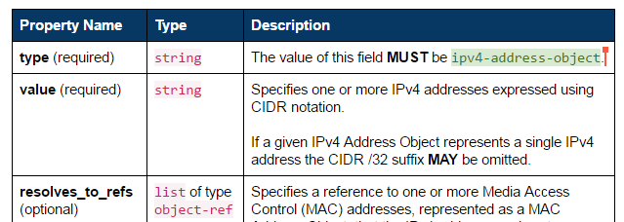
OASIS CTI Data Definitions
STIX, TAXII, CybOX specified using Property Tables
Abstract description
Independent of serialization (XML, JSON, binary)
Informal definition of data objects
Table cell contents follow conventions, but …
Free-form text, cannot be machine parsed, validated, or translated
Interim step toward formal abstract specifications?
Would enable automated translation to concrete schemas:
XSD
JSON Schema
Proto3
…

Slide 6
OpenC2 Data Definitions
Current implementation: Python abstract data structures
Executable: enables encoding- independent message validation
Defines OpenC2 abstract syntax
Unambiguous type checking
Validates example messages
Supports multiple message formats
Verbose JSON
Concise JSON
Minimized JSON
Corresponds directly to informal property tables and formal abstract syntax
class OpenC2Command(Record): vals = [ ('action', Action, ''), ('target', Target, ''), ('actuator', Actuator, '?'), ('modifiers', Modifiers, '?')]
class Action(Enumerated):
vals = [
'scan', # 1
'locate', # 2
'query', # 3
...
'remediate'] # 35
class Target(Record):
vals = [
('type', TargetTypeValue , ''),
('specifiers', cybox.CyboxObject,
'?,{type}')]

Slide 7
Abstract Syntax - Structures
JSON Data Model
Array – ordered list of items
Item has position, no name
Object – unordered set of properties
Property has name, no position
Abstract Data Model
Record – ordered list of fields
Field has both name and position
Encoded in JSON as either Array or Object
Decoder restores names to Array fields, positions to Object fields
Map – unordered set of fields
Field has name, no position
Encoded in JSON as Object
class OpenC2Command(Record): vals = [ ('action', Action, ''), ('target', Target, ''), ('actuator', Actuator, '?'), ('modifiers', Modifiers, '?')]

Slide 8
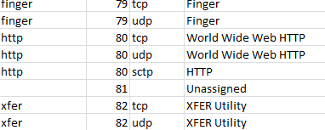
Abstract Syntax – Names
JSON Data Model
Names transmitted as strings
Field names / property keys (e.g., “type”, “value”, “Action”)
Literals in a vocabulary (e.g., “ipv4-address-object”, “TCP”, “scan”)
Abstract Data Model
Names transmitted as either strings or tags
Tags (ElementIDs) assigned to Names in a registry
Example - port numbers:
class Action(Enumerated):
vals = [
'scan', # 1
'locate', # 2
'query', # 3
...
'remediate'] # 35

Slide 9
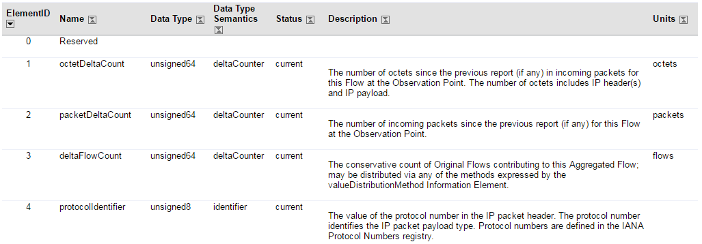
Abstract Syntax – Names (cont.)
IP Flow Information Export (IPFIX) element registry
Abstract syntax assigns IDs (1) to names (“octetDeltaCount”)
Concrete encoding uses one or the other
Decoder supplies name corresponding to received ID
Namespace needed to identify registry – IANA/IPFIX

Slide 10
JSON Encodings
Verbose
Records encoded as Objects
Highest bandwidth
Arguably most human-readable (explicit field names)
Concise
Records encoded as Arrays
Reduced bandwidth
Arguably more readable (no field name clutter)
Minimized
Records encoded as Arrays, Names encoded as Tags
Most bandwidth efficient, least readable
Use directly for transmission, or as visualization of binary encoding

Slide 11
JSON Abstract Syntax Notation (JASN)
JSON document that defines an abstract schema
Translate to concrete schemas
Import directly by applications

Slide 12
Vision
Abstract Schema Definitions
Generate Concrete Message Schemas
Applications use abstract or concrete schemas
Python Classes
Property Tables
JASN
Pseudo ASN
ASN.1
JSON Schema Verbose
JSON Schema Concise
JSON Schema Minimized
XSD
Proto3 Binary
Other Binary?
Producer
Consumer
JASN
JSON Schema
Message

Slide 13
Decisions and Lessons Learned
Distributed development (namespaces)
No generally-accepted namespace approach for JSON
Forced to roll our own to import both CybOX 2 and CybOX 3
Balance between include and reference
CybOX 2 vs CybOX 3
Think Abstract
Focus on what information is needed
Not how it is represented

Slide 14
Next Steps

